Slide 1
Tutorial 1 Simple Linear Regression
Niklas Bacher, Jonas Schrade
Konstanz, 21.04.2021, Statistics

Slide 2
Disclaimer!!
The content of the slides partly relies on material of Philipp Prinz, Philipp Scherer and Jens Wiederspohn, former Statistics tutors. Like us, they are students. Therefore, we provide no guarantee for the content of the slides or other data/information of the tutorial.
Please note that the slides will not cover the entire lecture content. To pass the exam, it is still absolutely necessary to deal with the Wooldridge in detail!

Slide 3
Econometrics in General
What is econometrics all about?
Econometrics = statistics for economists (and politicians)
Mathematical tools (e.g. regression) for economic problems
Different focus and interpretation
Use of statistical methods and empirical data to...
estimate (economic) relationships
test theories
evaluate policies
forecast variables

Slide 4
Econometrics in General
What is an econometric model in general?
Econometric models are formalized economic models
How does demand change if the prices are increased? demand_{i} = β₀ + β₁ ∗ price_{i} + u_{i}
What is the effect of election fraud on re-election perspectives votes_{i} = β₀ + β₁ ∗ ability_{i} + β₂ ∗ integrity_{i} + β₃ ∗ fraud_{i} + u_{i}
Relationship between dependent and independent variables
The behaviour of variables is described with equations
Parameters (β) are estimates of the effect size of a variable
Error term (u) contains all unobserved factors
Specification of error term affects models massively!

Slide 5
Econometrics in General
Important data structures and their characteristics
Cross sectional data
Sample of units at one point in time (ignore small time diff.)
Time Series Data
Observations on a variable over time (annually, monthly,...)
Often, we need to account for time dependency of data
Pooled Cross Sections
Combination of cross sections to increase sample size
Random samples → ”same population”
Panel or Longitudinal Data
Time series for each member in cross-sectional data set
Data on the same units across time
Allows estimation of effect over time + new methods (e.g. FE)

Slide 6
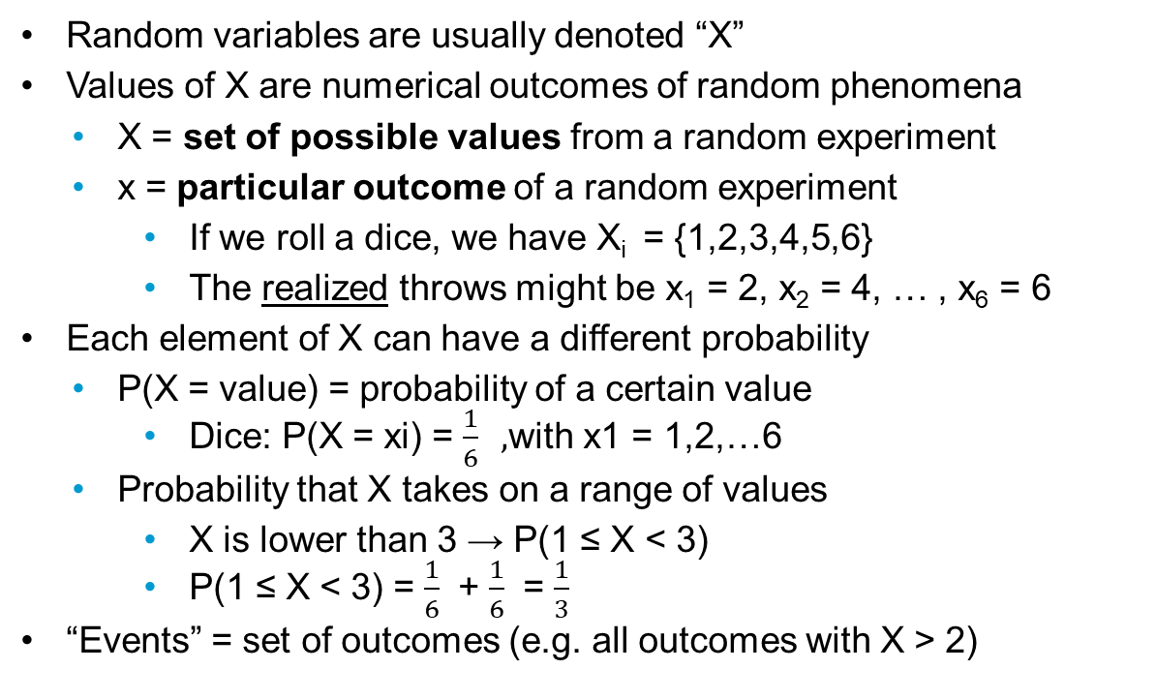
Random Variables
Random variables are usually denoted “X”
Values of X are numerical outcomes of random phenomena
X = set of possible values from a random experiment
x = particular outcome of a random experiment
If we roll a dice, we have X_{i} = {1,2,3,4,5,6}
The realized throws might be x₁ = 2, x₂ = 4, … , x₆ = 6
Each element of X can have a different probability
P(X = value) = probability of a certain value
Dice: P(X = xi) = $\frac{1}{6} ,$with x1 = 1,2,…6
Probability that X takes on a range of values
X is lower than 3 → P(1 ≤ X < 3)
P(1 ≤ X < 3) = $\frac{1}{6}$ + $\frac{1}{6}$ = $\frac{1}{3}$
“Events” = set of outcomes (e.g. all outcomes with X > 2)

Slide 7
Discrete vs. continuous
Two types of random variables
Discrete random variables → Probabilty mass function
Takes a countable number of distinct values (0,1,2,3,…)
Most often, discrete random variables are counts
Number of attendants in a tutorial, inhabitants, …
Continuous random variables → Probability density function
takes an infinite number of possible values
→ Probability of a single value is 0!
→ not defined at specific values → interval of values!
Represented by area under curve (integral)
Height, weight, time, …

Slide 8
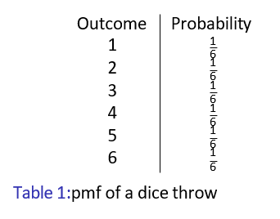

Probability mass function
Probability distribution of a discrete variable
List of probabilities associated with the possible values of X
E.g. P(X = x_{i}) = $\frac{1}{6}$, i = 1,2,…,6
Or:

Slide 9
Probability density function
Probability distribution of a continuous random variable
Density curve represents pdf
Curve must not have negative values
Total area under the curve (=probability) is equal to 1
Most important continuous pdf is the normal distribution
P(X = x) → P(Z = z)
E.g. what is the probability that Z is larger than 1.96

Slide 10
Random Variables

Slide 11
Herzlichen Dank!
Niklas Bacher Jonas Schrade
Statistics · Fachbereich Politik- und Verwaltungswissenschaft
niklas.bacher@uni-konstanz.de
jonas.schrade@uni-konstanz.de

